Slide 1
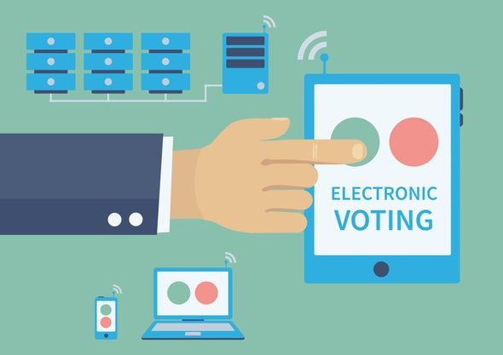
Online Voting System

Slide 2


Team iMPacT
Sandeep Kumar - RA2011047010154
Ajay - RA2011047010114
Rahi Jain - RA2011047010084
Charith Varma - RA2011047010128
Tharun - RA2011047010086

Slide 3

PROBLEM STATEMENT
Nowadays situation is very bad due to corona , So during elections most of people are not using their vote right by staying at home with fear .
So how to solve this solution ??
We found a system that will make people to vote in their homes and use their valuable vote right.

Slide 4
ABSTRACT
The main objective of the project is to make use of vote right by all by staying in home safe
This project is useful for old age people , where there is a high chance of attacking of virus to them .
They can easily vote to their supporting party while staying in home .
It is Very High Restricted ---- High security Platform.
It is the future of Voting Using { AI , Data Science }

Slide 5
PROJECT DESCRIPTION
It is based on OTP, Adhar linking , Voter card linking , Face recognition with time limit .
This process has many risks , because its an government process .
This project needs so many permissions form the Government of India.
It has high chance of cheating while in online, So we took so many measures to prevent that.
It can be used in any of the android devices and personal computers .
It can be made in two platforms as website or an application.
It is an HUGE project with so many risks involed , So we have Chosen::::>

Slide 6
MODEL WE CHOOSEN
SPIRAL MODEL
Our project follows Spiral Model:
Spiral Model is divided into four quadrants
Objectives determination and identify alternative solutions.
Identify and resolve Risks.
Develop next version of the Product.
Review and plan for the next Phase

Slide 7
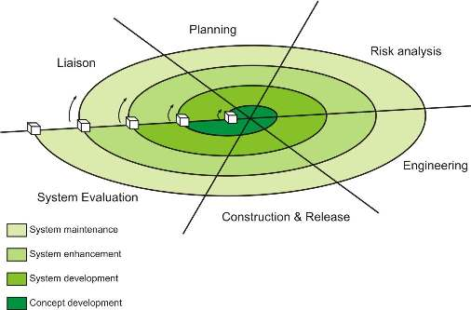
SPIRAL MODEL IN DIAGRAM FORMAT

Slide 8

Why we choose spiral Model ?
Additional functionality or changes can be done at a later stage
Cost estimation becomes easy as the prototype building is done in small fragments
Continuous or repeated development helps in risk management
Development is fast and features are added in a systematic way in Spiral development
There is always a space for customer feedback

Slide 9
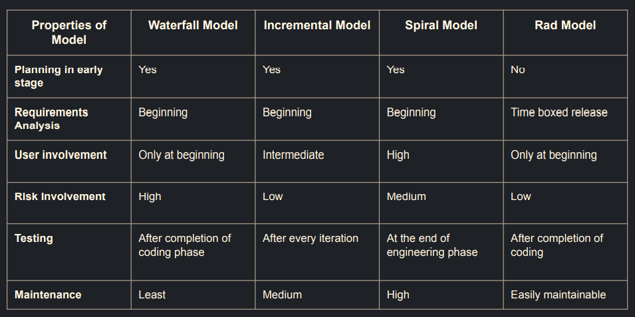
SPIRAL MODEL vs OTHER Models

Slide 10

THANK YOU
From Team iMPacT
Hope This Slides Provides all The Brief Information About the Software That Is
Online voting System
TEAM

